Slide 1
Part III: Relevant ethics and regulations for protecting genetic privacy
Notes:
Good morning! Today I am going to talk about a software program recently developed by me and my colleagues, PEAKS, for de novo sequencing and protein identification.

Slide 2
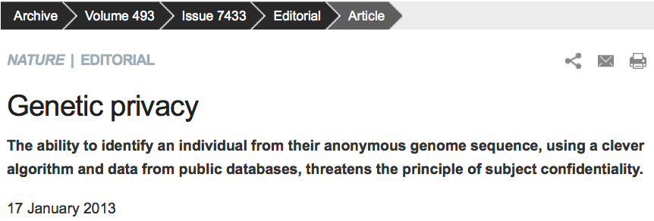
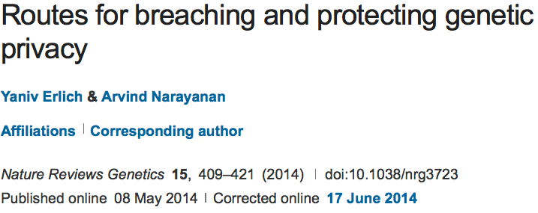
Genetic Privacy

Slide 3

Health Insurance Portability and Accountability Act (HIPAA) Breaches
More than 41 million people have had their protected health information compromised in HIPAA privacy and security breaches.
https://www.hhs.gov/hipaa/index.html

Slide 4
Ethics of genetic privacy and current regulations
Standards for Privacy of Individually Identifiable Health Information in the Health Insurance Portability and Accountability Act of 1996 (HIPAA).
The Privacy Rule was established to address the use and disclosure of individuals’ health information by covered entities, and provides standards for individual privacy rights to understand and control the use of their health information.
Many large human genome projects provide ethics education
Shi, Xinghua, and Xintao Wu. "An overview of human genetic privacy." Annals of the New York Academy of Sciences 1387.1 (2017): 61-72.

Slide 5
Ethics and HIPAA Review
Key to advancing genetics diagnosis research
Private personal health information can be protected
Discrimination/Bias based on released heath information can be eliminated (minimized)
HIPAA Privacy Rule: All federal grants with human subjects involved should be protected by HIPAA
https://www.hhs.gov/hipaa/index.html

Slide 6
Introduction to HIPAA
The Standards for Privacy of Individually Identifiable Health Information (“Privacy Rule”) establishes, for the first time, a set of national standards for the protection of =certain health information.
The U.S. Department of Health and Human Services (“HHS”) issued the Privacy Rule to implement the requirement of the Health Insurance Portability and Accountability Act of 1996 (“HIPAA”).
The Privacy Rule standards address the use and disclosure of individuals’ health information—called “protected health information” by organizations subject to the Privacy Rule — called “covered entities,” as well as standards for individuals' privacy rights to understand and control how their health information is used.
Within HHS, the Office for Civil Rights (“OCR”) has responsibility for implementing and enforcing the Privacy Rule with respect to voluntary compliance activities and civil money penalties.
https://www.hhs.gov/hipaa/index.html

Slide 7
Information Protected by HIPAA
Protected Health Information
  The Privacy Rule protects all “individually identifiable health information”
  only covers patient information kept by health providers, insurers and data clearinghouses, as well as their business partners
De-Identified Health Information.
  There are no restrictions on the use or disclosure of de-identified health information.
https://www.hhs.gov/hipaa/index.html

Slide 8
Information NOT Protected by HIPPA
De-identified health information
Medical information not originated from entities not covered by HIPAA (e.g. 23andMe, genetic screening companies)
Consumer-generated health information (home paternity tests, fitness trackers, health apps, social media)
Personal information (ethic, identity, etc.) inferred from de-identified health information
Meta data such as age, geographical regions, races of participants
Shi, Xinghua, and Xintao Wu. "An overview of human genetic privacy." Annals of the New York Academy of Sciences 1387.1 (2017): 61-72.

Slide 9
HIPAA Safe Harbor Rule
Dissemination of demographic identifiers has been the subject of tight regulation in the US health care system.
The maximal resolution of any date field, such as hospital admission dates, is in years.
The maximal resolution of a geographical subdivision is the first three digits of a zip code (for zip code areas with populations of >20,000).
Shi, Xinghua, and Xintao Wu. "An overview of human genetic privacy." Annals of the New York Academy of Sciences 1387.1 (2017): 61-72.
Notes:
A standard in the HIPAA rule for de-identification of protected health information by removing 18 bytes of quasi-identifiers (residual pieces of information embedded in the data set).

Slide 10

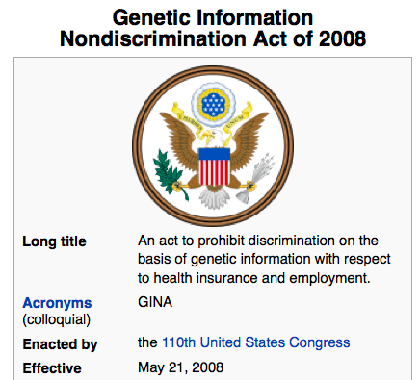
The Genetic Information Nondiscrimination Act (GINA)
http://www.ginahelp.org/GINAhelp.pdf

Slide 11
Genetic Privacy
De-identification is insufficient to protect identity
Homer N, et al. Plos Genetics, 2008
  Suggest that composite statistics across cohorts, such as allele frequency or genotype counts, do not mask identity within genome-wide association studies.
Aggregate data can be harmful as far as privacy is concerned.
The genotype-phenotype data (dbGaP) at NIH is controlled access.

Slide 12
Genetic Privacy
Gymrek M, et al. Science, 2013
  Use the 1000 Genomes Project Phase 1 data with whole genome sequences of 1,092 individuals (no phenotypes so publicly accessible)
  Surnames can be recovered from personal genomes by profiling short tandem repeats on the Y chromosome (Y-STRs) and querying recreational genetic genealogy databases.
  A combination of a surname with other types of metadata, such as age and state, can be used to triangulate the identity of the target.
  Age information is taken out from the publicly accessible 1000 Genomes Project data.
S.S. Shringarpure and C.D. Bustamante, “Privacy leaks from genomic data-sharing beacons,” The American Journal of Human Genetics, 97: 1-15, 2015.

Slide 13
NIH Policy and Ethics Issues
Coverage and Reimbursement of Genetic Tests
Genetic Discrimination
Informed Consent for Genomic Research
Intellectual Property
Privacy in Genomics
Regulation of Genetic Tests
https://www.genome.gov/27527631/policy--ethics-issues/

Slide 14
Coverage and Reimbursement of Genetic Tests
Genomic medicine has the capacity to revolutionize clinical practice.
One challenge insurers face is the difficulty of deciding when to reimburse for genetic tests that health care providers have offered their patients.
Payers are having trouble keeping up with the volume of new genetic and next-generation sequencing tests that are coming onto the market.
https://www.genome.gov/19016729/coverage-and-reimbursement-of-genetic-tests/

Slide 15
Genetic Discrimination
Many Americans fear that participating in research or undergoing genetic testing will lead to being discriminated against based on their genetics.
The Genetic Information Nondiscrimination Act (GINA) was passed into law, prohibiting discrimination by employers and health insurers.
There are also other legal protections against genetic discrimination by employers, health insurers, and others.
https://www.genome.gov/10002077/genetic-discrimination/

Slide 16
Informed Consent for Genomic Research
Advances in genomic technology and analytical tools are enabling discoveries that enhance our understanding of the impact of genomic variants on health and disease.
Informed consent shows respect for personal autonomy and is an important ethical requirement in research. (HIPAA Privacy Rule)
Informed consent involves two fundamental components: a dialogue or process, and a form.
https://www.genome.gov/27026588/informed-consent-for-genomics-research/

Slide 17
Intellectual Property
In a landmark decision in June 2013, the Supreme Court determined that DNA in its natural form cannot be patented.
The National Human Genome Research Institute (NHGRI) to research "legal issues regarding patents" as part of the then center's research into the ethical, social, and legal implications of human genome research.
The Courts and Gene Patents
https://www.genome.gov/19016590/intellectual-property/

Slide 18
Privacy in Genomics
Each person's DNA sequence includes health and other information about them and their families.
Usage and privacy need to be balanced.
Genetic Information Nondiscrimination Act (GINA)
The HIPAA Privacy Rule
Certificates of Confidentiality
The Freedom of Information Act (FOIA)
NIH Genomic Data Sharing Policy
https://www.genome.gov/27561246/privacy-in-genomics/

Slide 19
Regulation of Genetic Tests
Genetic tests focus on an individual's inheritance of a single gene, while genomic tests look at an individual's wider inheritance of various genetic traits.
Analytical Validity
Clinical Validity
Clinical Utility
CMS Regulation: Clinical Laboratory Improvement Amendments (CLIA)
FDA Regulation
https://www.genome.gov/10002335/regulation-of-genetic-tests/

Slide 20
References
Shi, Xinghua, and Xintao Wu. "An overview of human genetic privacy." Annals of the New York Academy of Sciences 1387.1 (2017): 61-72.
Erlich, Yaniv, and Arvind Narayanan. "Routes for breaching and protecting genetic privacy." Nature Reviews Genetics 15.6 (2014): 409.

